Slide 1
Relations
Introduction

Slide 2
Relation - Introduction
Definition: A binary relation R from a set A to a set B is a subset R ⊆ A × B

Slide 3
Relation - Introduction
Definition: A binary relation R from a set A to a set B is a subset R ⊆ A × B
Example:
Let A = {0,1,2} and B = {a,b}

Slide 4
Relation - Introduction
Definition: A binary relation R from a set A to a set B is a subset R ⊆ A × B
Example:
Let A = {0,1,2} and B = {a,b}
{(0, a), (0, b), (1,a) , (2, b)} is a relation from A to B

Slide 5
Relation - Introduction
Definition: A binary relation R from a set A to a set B is a subset R ⊆ A × B
Example:
Let A = {0,1,2} and B = {a,b}
{(0, a), (0, b), (1,a) , (2, b)} is a relation from A to B
Relations are more general than functions. A function is a relation where exactly one element of B is related to each element of A

Slide 6
Relation - Introduction
Representation:
Let A = {0,1,2} and B = {a,b}
{(0, a), (0, b), (1,a) , (2, b)} is a relation from A to B

Slide 7
Relation - Introduction
Representation:
Let A = {0,1,2} and B = {a,b}
{(0, a), (0, b), (1,a) , (2, b)} is a relation from A to B
Graphical Representation

Slide 8
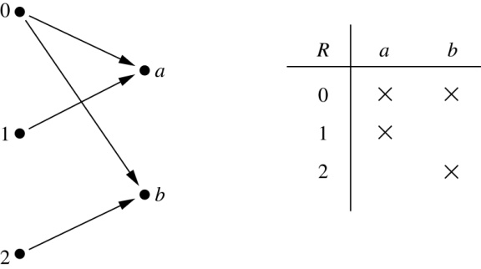
Relation - Introduction
Representation:
Let A = {0,1,2} and B = {a,b}
{(0, a), (0, b), (1,a) , (2, b)} is a relation from A to B
Graphical Representation

Slide 9
Relation - Introduction
Representation:
Let A = {0,1,2} and B = {a,b}
{(0, a), (0, b), (1,a) , (2, b)} is a relation from A to B
Table Representation

Slide 10
Relation - Introduction
Representation:
Let A = {0,1,2} and B = {a,b}
{(0, a), (0, b), (1,a) , (2, b)} is a relation from A to B
Table Representation

Slide 11
Relation – Binary Relation on a set
Definition:

Slide 12
Relation – Binary Relation on a set
Definition: A binary relation R on a set A is a subset of A × A i.e. R ⊆ A × A or a relation from A to A

Slide 13
Relation – Binary Relation on a set
Definition: A binary relation R on a set A is a subset of A × A i.e. R ⊆ A × A or a relation from A to A
Example 01:
A = {a, b, c}

Slide 14
Relation – Binary Relation on a set
Definition: A binary relation R on a set A is a subset of A × A i.e. R ⊆ A × A or a relation from A to A
Example 01:
A = {a, b, c}
R = {(a, a), (a, b), (a, c)} is a relation on A

Slide 15
Relation – Binary Relation on a set
Definition: A binary relation R on a set A is a subset of A × A i.e. R ⊆ A × A or a relation from A to A
Example 02:
Let A = {1, 2, 3, 4}. The ordered pairs in the relation R = {(a,b) | a divides b} are

Slide 16
Relation – Binary Relation on a set
Definition: A binary relation R on a set A is a subset of A × A i.e. R ⊆ A × A or a relation from A to A
Example 02:
Let A = {1, 2, 3, 4}. The ordered pairs in the relation R = {(a,b) | a divides b} are
R = {(1,1), (1, 2), (1,3), (1, 4), (2, 2), (2, 4), (3, 3), (4, 4)}

Slide 17
Relation – Maximum # of Relations on Set A
# of elements in A

Slide 18
Relation – Maximum # of Relations on Set A
# of elements in A = |A|= n

Slide 19
Relation – Maximum # of Relations on Set A
# of elements in A = |A|= n
# of elements in a subset of A

Slide 20
Relation – Maximum # of Relations on Set A
# of elements in A = |A|= n
# of elements in a subset of A = 2^{n}

Slide 21
Relation – Maximum # of Relations on Set A
# of elements in A = |A|= n
# of elements in a subset of A = 2^{n}
# of elements in A × A

Slide 22
Relation – Maximum # of Relations on Set A
# of elements in A = |A|= n
# of elements in a subset of A = 2^{n}
# of elements in A × A = |A|²= n²

Slide 23
Relation – Maximum # of Relations on Set A
# of elements in A = |A|= n
# of elements in a subset of A = 2^{n}
# of elements in A × A = |A|²= n²
A binary relation is a subset of A × A

Slide 24
Relation – Maximum # of Relations on Set A
# of elements in A = |A|= n
# of elements in a subset of A = 2^{n}
# of elements in A × A = |A|²= n²
A binary relation is a subset of A × A
# of elements in a Relation R on A

Slide 25

Relation – Maximum # of Relations on Set A
# of elements in A = |A|= n
# of elements in A × A = |A|²= n²
# of elements in a subset of A = 2^{n}
A binary relation is a subset of A × A
# of elements in a Relation R on A
For example, if A = {1, 2}. Then
AXA = {(1,1), (1,2), (2,1), (2,2)}. So, |AXA| = 4 = 2²
Hence, number of relations on A = 2⁴ = 16 (i.e. power set of AXA.

Slide 26
Relation – Examples
Example 01: Consider these relations on the set of integers:
R₁ = {(a,b) | a ≤ b}, R₄ = {(a,b) | a = b},
R₂ = {(a,b) | a > b}, R₅ = {(a,b) | a = b + 1},
R₃ = {(a,b) | a = b or a = −b}, R₆ = {(a,b) | a + b ≤ 3}.

Slide 27
Relation – Examples
Example 01: Consider these relations on the set of integers:
R₁ = {(a,b) | a ≤ b}, R₄ = {(a,b) | a = b},
R₂ = {(a,b) | a > b}, R₅ = {(a,b) | a = b + 1},
R₃ = {(a,b) | a = b or a = −b}, R₆ = {(a,b) | a + b ≤ 3}.
Which of these relations contains (1, 1)

Slide 28
Relation – Examples
Example 01: Consider these relations on the set of integers:
R₁ = {(a,b) | a ≤ b}, R₄ = {(a,b) | a = b},
R₂ = {(a,b) | a > b}, R₅ = {(a,b) | a = b + 1},
R₃ = {(a,b) | a = b or a = −b}, R₆ = {(a,b) | a + b ≤ 3}.
Which of these relations contains (1, 1)
R1, R3, R4, R6

Slide 29
Relation – Examples
Example 02: Consider these relations on the set of integers:
R₁ = {(a,b) | a ≤ b}, R₄ = {(a,b) | a = b},
R₂ = {(a,b) | a > b}, R₅ = {(a,b) | a = b + 1},
R₃ = {(a,b) | a = b or a = −b}, R₆ = {(a,b) | a + b ≤ 3}.
Which of these relations contains (1, 2)

Slide 30
Relation – Examples
Example 02: Consider these relations on the set of integers:
R₁ = {(a,b) | a ≤ b}, R₄ = {(a,b) | a = b},
R₂ = {(a,b) | a > b}, R₅ = {(a,b) | a = b + 1},
R₃ = {(a,b) | a = b or a = −b}, R₆ = {(a,b) | a + b ≤ 3}.
Which of these relations contains (1, 2)
R1, R6

Slide 31
Relation – Examples
Example 03: Consider these relations on the set of integers:
R₁ = {(a,b) | a ≤ b}, R₄ = {(a,b) | a = b},
R₂ = {(a,b) | a > b}, R₅ = {(a,b) | a = b + 1},
R₃ = {(a,b) | a = b or a = −b}, R₆ = {(a,b) | a + b ≤ 3}.
Which of these relations contains (2, 1)

Slide 32
Relation – Examples
Example 03: Consider these relations on the set of integers:
R₁ = {(a,b) | a ≤ b}, R₄ = {(a,b) | a = b},
R₂ = {(a,b) | a > b}, R₅ = {(a,b) | a = b + 1},
R₃ = {(a,b) | a = b or a = −b}, R₆ = {(a,b) | a + b ≤ 3}.
Which of these relations contains (2, 1)
R2, R5, R6

Slide 33
Relation – Examples
Example 04: Consider these relations on the set of integers:
R₁ = {(a,b) | a ≤ b}, R₄ = {(a,b) | a = b},
R₂ = {(a,b) | a > b}, R₅ = {(a,b) | a = b + 1},
R₃ = {(a,b) | a = b or a = −b}, R₆ = {(a,b) | a + b ≤ 3}.
Which of these relations contains (1, -1)

Slide 34
Relation – Examples
Example 04: Consider these relations on the set of integers:
R₁ = {(a,b) | a ≤ b}, R₄ = {(a,b) | a = b},
R₂ = {(a,b) | a > b}, R₅ = {(a,b) | a = b + 1},
R₃ = {(a,b) | a = b or a = −b}, R₆ = {(a,b) | a + b ≤ 3}.
Which of these relations contains (1, -1)
R2, R3, R6

Slide 35
Relation – Examples
Example 05: Consider these relations on the set of integers:
R₁ = {(a,b) | a ≤ b}, R₄ = {(a,b) | a = b},
R₂ = {(a,b) | a > b}, R₅ = {(a,b) | a = b + 1},
R₃ = {(a,b) | a = b or a = −b}, R₆ = {(a,b) | a + b ≤ 3}.
Which of these relations contains (2, 2)

Slide 36
Relation – Examples
Example 05: Consider these relations on the set of integers:
R₁ = {(a,b) | a ≤ b}, R₄ = {(a,b) | a = b},
R₂ = {(a,b) | a > b}, R₅ = {(a,b) | a = b + 1},
R₃ = {(a,b) | a = b or a = −b}, R₆ = {(a,b) | a + b ≤ 3}.
Which of these relations contains (2, 2)
R1, R3, R4

Slide 37
Relation – Types
Reflexive Relation:

Slide 38
Relation – Types
Reflexive Relation: R is reflexive iff (a,a) ∊ R for every element a ∊ A , ∀x[x ∊ U ⟶ (x, x) ∊ R]

Slide 39
Relation – Types
Reflexive Relation: R is reflexive iff (a,a) ∊ R for every element a ∊ A , ∀x[x ∊ U ⟶ (x, x) ∊ R]
R₁ = {(a,b) | a ≤ b}
R₃ = {(a,b) | a = b or a = −b}
R₄ = {(a,b) | a = b}
R₂ = {(a,b) | a > b}
R₅ = {(a,b) | a = b + 1}
R₆ = {(a,b) | a + b ≤ 3}

Slide 40

Relation – Types
Reflexive Relation: R is reflexive iff (a,a) ∊ R for every element a ∊ A , ∀x[x ∊ U ⟶ (x, x) ∊ R]
R₁ = {(a,b) | a ≤ b}
R₃ = {(a,b) | a = b or a = −b}
R₄ = {(a,b) | a = b}
R₂ = {(a,b) | a > b}
R₅ = {(a,b) | a = b + 1}
R₆ = {(a,b) | a + b ≤ 3}

Slide 41
Relation – Types
Reflexive Relation: R is reflexive iff (a,a) ∊ R for every element a ∊ A , ∀x[x ∊ U ⟶ (x, x) ∊ R]
R₁ = {(a,b) | a ≤ b}
R₃ = {(a,b) | a = b or a = −b}
R₄ = {(a,b) | a = b}
R₂ = {(a,b) | a > b}
R₅ = {(a,b) | a = b + 1}
R₆ = {(a,b) | a + b ≤ 3}

Slide 42
Relation – Types
Reflexive Relation: R is reflexive iff (a,a) ∊ R for every element a ∊ A , ∀x[x ∊ U ⟶ (x, x) ∊ R]
R₁ = {(a,b) | a ≤ b}
R₃ = {(a,b) | a = b or a = −b}
R₄ = {(a,b) | a = b}
R₂ = {(a,b) | a > b}
R₅ = {(a,b) | a = b + 1}
R₆ = {(a,b) | a + b ≤ 3}

Slide 43

Relation – Types
Reflexive Relation: R is reflexive iff (a,a) ∊ R for every element a ∊ A , ∀x[x ∊ U ⟶ (x, x) ∊ R]
R₁ = {(a,b) | a ≤ b}
R₃ = {(a,b) | a = b or a = −b}
R₄ = {(a,b) | a = b}
R₂ = {(a,b) | a > b} (note that 3 ≯ 3)
R₅ = {(a,b) | a = b + 1}
R₆ = {(a,b) | a + b ≤ 3}

Slide 44
Relation – Types
Reflexive Relation: R is reflexive iff (a,a) ∊ R for every element a ∊ A , ∀x[x ∊ U ⟶ (x, x) ∊ R]
R₁ = {(a,b) | a ≤ b}
R₃ = {(a,b) | a = b or a = −b}
R₄ = {(a,b) | a = b}
R₂ = {(a,b) | a > b} (note that 3 ≯ 3)
R₅ = {(a,b) | a = b + 1} (note that 3 ≠3 + 1)
R₆ = {(a,b) | a + b ≤ 3}

Slide 45
Relation – Types
Reflexive Relation: R is reflexive iff (a,a) ∊ R for every element a ∊ A , ∀x[x ∊ U ⟶ (x, x) ∊ R]
R₁ = {(a,b) | a ≤ b}
R₃ = {(a,b) | a = b or a = −b}
R₄ = {(a,b) | a = b}
R₂ = {(a,b) | a > b} (note that 3 ≯ 3)
R₅ = {(a,b) | a = b + 1} (note that 3 ≠3 + 1)
R₆ = {(a,b) | a + b ≤ 3} (note that 4 + 4 ≰ 3)

Slide 46
Relation – Types
Symmetric Relation:

Slide 47
Relation – Types
Symmetric Relation: R is symmetric iff (b,a) ∊ R whenever (a,b) ∊ R for all a,b ∊ A ,
∀x∀y [(x, y) ∊ R ⟶ (y, x) ∊ R]

Slide 48
Relation – Types
Symmetric Relation: R is symmetric iff (b,a) ∊ R whenever (a,b) ∊ R for all a,b ∊ A ,
∀x∀y [(x, y) ∊ R ⟶ (y, x) ∊ R]
R₃ = {(a,b) | a = b or a = −b}
R₄ = {(a,b) | a = b}
R₆ = {(a,b) | a + b ≤ 3}
R₁ = {(a,b) | a ≤ b}
R₂ = {(a,b) | a > b}
R₅ = {(a,b) | a = b + 1}

Slide 49
Relation – Types
Symmetric Relation: R is symmetric iff (b,a) ∊ R whenever (a,b) ∊ R for all a,b ∊ A ,
∀x∀y [(x, y) ∊ R ⟶ (y, x) ∊ R]
R₃ = {(a,b) | a = b or a = −b}
R₄ = {(a,b) | a = b}
R₆ = {(a,b) | a + b ≤ 3}
R₁ = {(a,b) | a ≤ b}
R₂ = {(a,b) | a > b}
R₅ = {(a,b) | a = b + 1}

Slide 50
Relation – Types
Symmetric Relation: R is symmetric iff (b,a) ∊ R whenever (a,b) ∊ R for all a,b ∊ A ,
∀x∀y [(x, y) ∊ R ⟶ (y, x) ∊ R]
R₃ = {(a,b) | a = b or a = −b}
R₄ = {(a,b) | a = b}
R₆ = {(a,b) | a + b ≤ 3}
R₁ = {(a,b) | a ≤ b}
R₂ = {(a,b) | a > b}
R₅ = {(a,b) | a = b + 1}

Slide 51
Relation – Types
Symmetric Relation: R is symmetric iff (b,a) ∊ R whenever (a,b) ∊ R for all a,b ∊ A ,
∀x∀y [(x, y) ∊ R ⟶ (y, x) ∊ R]
R₃ = {(a,b) | a = b or a = −b}
R₄ = {(a,b) | a = b}
R₆ = {(a,b) | a + b ≤ 3}
R₁ = {(a,b) | a ≤ b}
R₂ = {(a,b) | a > b}
R₅ = {(a,b) | a = b + 1}

Slide 52
Relation – Types
Symmetric Relation: R is symmetric iff (b,a) ∊ R whenever (a,b) ∊ R for all a,b ∊ A ,
∀x∀y [(x, y) ∊ R ⟶ (y, x) ∊ R]
R₃ = {(a,b) | a = b or a = −b}
R₄ = {(a,b) | a = b}
R₆ = {(a,b) | a + b ≤ 3}
R₁ = {(a,b) | a ≤ b} (note that 3 ≤ 4, but 4 ≰ 3)
R₂ = {(a,b) | a > b}
R₅ = {(a,b) | a = b + 1}

Slide 53
Relation – Types
Symmetric Relation: R is symmetric iff (b,a) ∊ R whenever (a,b) ∊ R for all a,b ∊ A ,
∀x∀y [(x, y) ∊ R ⟶ (y, x) ∊ R]
R₃ = {(a,b) | a = b or a = −b}
R₄ = {(a,b) | a = b}
R₆ = {(a,b) | a + b ≤ 3}
R₁ = {(a,b) | a ≤ b} (note that 3 ≤ 4, but 4 ≰ 3)
R₂ = {(a,b) | a > b} (note that 4 > 3, but 3 ≯ 4)
R₅ = {(a,b) | a = b + 1}

Slide 54
Relation – Types
Symmetric Relation: R is symmetric iff (b,a) ∊ R whenever (a,b) ∊ R for all a,b ∊ A ,
∀x∀y [(x, y) ∊ R ⟶ (y, x) ∊ R]
R₃ = {(a,b) | a = b or a = −b}
R₄ = {(a,b) | a = b}
R₆ = {(a,b) | a + b ≤ 3}
R₁ = {(a,b) | a ≤ b} (note that 3 ≤ 4, but 4 ≰ 3)
R₂ = {(a,b) | a > b} (note that 4 > 3, but 3 ≯ 4)
R₅ = {(a,b) | a = b + 1} (note that 4 = 3 + 1, but 3 ≠4 + 1)

Slide 55
Relation – Types
Asymmetric Relation:

Slide 56

Relation – Types
Asymmetric Relation:
A relation $R$on a set $A$is asymmetric if:
$∀a,b∈A, \left(a,b\right) \text{∊} \text{R}\text{⟶} \left(b,a\right)$∉ R

Slide 57
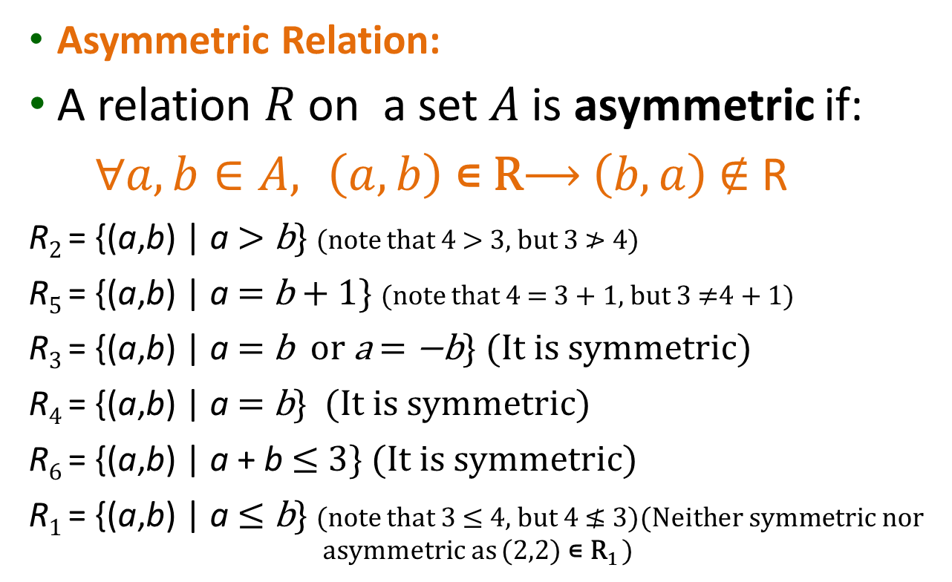
Relation – Types
Asymmetric Relation:
A relation $R$ on a set $A$is asymmetric if:
$∀a,b∈A, \left(a,b\right) \text{∊} \text{R}\text{⟶} \left(b,a\right)$∉ R
R₂ = {(a,b) | a > b} (note that 4 > 3, but 3 ≯ 4)
R₅ = {(a,b) | a = b + 1} (note that 4 = 3 + 1, but 3 ≠4 + 1)
R₃ = {(a,b) | a = b or a = −b} (It is symmetric)
R₄ = {(a,b) | a = b} (It is symmetric)
R₆ = {(a,b) | a + b ≤ 3} (It is symmetric)
R₁ = {(a,b) | a ≤ b} (note that 3 ≤ 4, but 4 ≰ 3)(Neither symmetric nor asymmetric as (2,2) $\text{∊} \text{R}\text{1}$ )

Slide 58
Relation – Types
Antisymmetric Relation:

Slide 59
Relation – Types
Antisymmetric Relation: A relation R on a set A such that for all a, b ∊ A if (a,b) ∊ R and (b,a) ∊ R, then a = b is called antisymmetric,
∀x∀y [(x, y) ∊R ∧ (y, x) ∊ R ⟶ x = y]
(i.e. if both directions exist, then both elements must be the same)

Slide 60
Relation – Types
Antisymmetric Relation: A relation R on a set A such that for all a, b ∊ A if (a,b) ∊ R and (b,a) ∊ R, then a = b is called antisymmetric,
∀x∀y [(x,y) ∊R ∧ (y,x) ∊ R ⟶ x = y]
R₁ = {(a,b) | a ≤ b},
R₂ = {(a,b) | a > b},
R₄ = {(a,b) | a = b},
R₃ = {(a,b) | a = b or a = −b}
R₆ = {(a,b) | a + b ≤ 3}

Slide 61
Relation – Types
Antisymmetric Relation: A relation R on a set A such that for all a, b ∊ A if (a,b) ∊ R and (b,a) ∊ R, then a = b is called antisymmetric,
∀x∀y [(x,y) ∊R ∧ (y,x) ∊ R ⟶ x = y]
R₁ = {(a,b) | a ≤ b},
R₂ = {(a,b) | a > b},
R₄ = {(a,b) | a = b},
R₃ = {(a,b) | a = b or a = −b}
R₆ = {(a,b) | a + b ≤ 3}

Slide 62
Relation – Types
Antisymmetric Relation: A relation R on a set A such that for all a, b ∊ A if (a,b) ∊ R and (b,a) ∊ R, then a = b is called antisymmetric,
∀x∀y [(x,y) ∊R ∧ (y,x) ∊ R ⟶ x = y]
R₁ = {(a,b) | a ≤ b},
R₂ = {(a,b) | a > b},
R₄ = {(a,b) | a = b},
R₃ = {(a,b) | a = b or a = −b}
R₆ = {(a,b) | a + b ≤ 3}

Slide 63
Relation – Types
Antisymmetric Relation: A relation R on a set A such that for all a, b ∊ A if (a,b) ∊ R and (b,a) ∊ R, then a = b is called antisymmetric,
∀x∀y [(x,y) ∊R ∧ (y,x) ∊ R ⟶ x = y]
R₁ = {(a,b) | a ≤ b},
R₂ = {(a,b) | a > b},
R₄ = {(a,b) | a = b},
R₃ = {(a,b) | a = b or a = −b}
R₆ = {(a,b) | a + b ≤ 3}

Slide 64
Relation – Types
Antisymmetric Relation: A relation R on a set A such that for all a, b ∊ A if (a,b) ∊ R and (b,a) ∊ R, then a = b is called antisymmetric,
∀x∀y [(x,y) ∊R ∧ (y,x) ∊ R ⟶ x = y]
R₁ = {(a,b) | a ≤ b},
R₂ = {(a,b) | a > b},
R₄ = {(a,b) | a = b},
R₃ = {(a,b) | a = b or a = −b} (note that both (1,−1) and (−1,1) belong to R₃)
R₆ = {(a,b) | a + b ≤ 3}

Slide 65
Relation – Types
Antisymmetric Relation: A relation R on a set A such that for all a, b ∊ A if (a,b) ∊ R and (b,a) ∊ R, then a = b is called antisymmetric,
∀x∀y [(x,y) ∊R ∧ (y,x) ∊ R ⟶ x = y]
R₁ = {(a,b) | a ≤ b}, (if a ≤ b and b ≤ a, then a = b)
R₂ = {(a,b) | a > b},
R₄ = {(a,b) | a = b},
R₃ = {(a,b) | a = b or a = −b} (note that both (1,−1) and (−1,1) belong to R₃)
R₆ = {(a,b) | a + b ≤ 3} (note that both (1,2) and (2,1) belong to R₆).

Slide 66
Relation – Types
Transitive Relation:

Slide 67
Relation – Types
Transitive Relation: A relation R on a set A is called transitive if whenever (a,b) ∊ R and (b,c) ∊ R, then (a,c) ∊ R, for all a,b,c ∊ A,
∀x∀y ∀z[(x,y) ∊R ∧ (y,z) ∊ R ⟶ (x,z) ∊ R ]

Slide 68
Relation – Types
Transitive Relation: A relation R on a set A is called transitive if whenever (a,b) ∊ R and (b,c) ∊ R, then (a,c) ∊ R, for all a,b,c ∊ A,
∀x∀y ∀z[(x,y) ∊R ∧ (y,z) ∊ R ⟶ (x,z) ∊ R ]
R₁ = {(a,b) | a ≤ b},
R₂ = {(a,b) | a > b},
R₃ = {(a,b) | a = b or a = −b},
R₄ = {(a,b) | a = b}.
R₅ = {(a,b) | a = b + 1}
R₆ = {(a,b) | a + b ≤ 3}

Slide 69
Relation – Types
Transitive Relation: A relation R on a set A is called transitive if whenever (a,b) ∊ R and (b,c) ∊ R, then (a,c) ∊ R, for all a,b,c ∊ A,
∀x∀y ∀z[(x,y) ∊R ∧ (y,z) ∊ R ⟶ (x,z) ∊ R ]
R₁ = {(a,b) | a ≤ b},
R₂ = {(a,b) | a > b},
R₃ = {(a,b) | a = b or a = −b},
R₄ = {(a,b) | a = b}.
R₅ = {(a,b) | a = b + 1}
R₆ = {(a,b) | a + b ≤ 3}

Slide 70
Relation – Types
Transitive Relation: A relation R on a set A is called transitive if whenever (a,b) ∊ R and (b,c) ∊ R, then (a,c) ∊ R, for all a,b,c ∊ A,
∀x∀y ∀z[(x,y) ∊R ∧ (y,z) ∊ R ⟶ (x,z) ∊ R ]
R₁ = {(a,b) | a ≤ b},
R₂ = {(a,b) | a > b},
R₃ = {(a,b) | a = b or a = −b},
R₄ = {(a,b) | a = b}.
R₅ = {(a,b) | a = b + 1}
R₆ = {(a,b) | a + b ≤ 3}

Slide 71
Relation – Types
Transitive Relation: A relation R on a set A is called transitive if whenever (a,b) ∊ R and (b,c) ∊ R, then (a,c) ∊ R, for all a,b,c ∊ A,
∀x∀y ∀z[(x,y) ∊R ∧ (y,z) ∊ R ⟶ (x,z) ∊ R ]
R₁ = {(a,b) | a ≤ b},
R₂ = {(a,b) | a > b},
R₃ = {(a,b) | a = b or a = −b},
R₄ = {(a,b) | a = b}.
R₅ = {(a,b) | a = b + 1}
R₆ = {(a,b) | a + b ≤ 3}

Slide 72
Relation – Types
Transitive Relation: A relation R on a set A is called transitive if whenever (a,b) ∊ R and (b,c) ∊ R, then (a,c) ∊ R, for all a,b,c ∊ A,
∀x∀y ∀z[(x,y) ∊R ∧ (y,z) ∊ R ⟶ (x,z) ∊ R ]
R₁ = {(a,b) | a ≤ b},
R₂ = {(a,b) | a > b},
R₃ = {(a,b) | a = b or a = −b},
R₄ = {(a,b) | a = b}.
R₅ = {(a,b) | a = b + 1}
R₆ = {(a,b) | a + b ≤ 3}

Slide 73
Relation – Types
Transitive Relation: A relation R on a set A is called transitive if whenever (a,b) ∊ R and (b,c) ∊ R, then (a,c) ∊ R, for all a,b,c ∊ A,
∀x∀y ∀z[(x,y) ∊R ∧ (y,z) ∊ R ⟶ (x,z) ∊ R ]
R₁ = {(a,b) | a ≤ b},
R₂ = {(a,b) | a > b},
R₃ = {(a,b) | a = b or a = −b},
R₄ = {(a,b) | a = b}.
R₅ = {(a,b) | a = b + 1} (note that both (3,2) and (2,1) belong to R₅, but not (3,1)),
R₆ = {(a,b) | a + b ≤ 3}

Slide 74
Relation – Types
Transitive Relation: A relation R on a set A is called transitive if whenever (a,b) ∊ R and (b,c) ∊ R, then (a,c) ∊ R, for all a,b,c ∊ A,
∀x∀y ∀z[(x,y) ∊R ∧ (y,z) ∊ R ⟶ (x,z) ∊ R ]
R₁ = {(a,b) | a ≤ b},
R₂ = {(a,b) | a > b},
R₃ = {(a,b) | a = b or a = −b},
R₄ = {(a,b) | a = b}.
R₅ = {(a,b) | a = b + 1} (note that both (3,2) and (2,1) belong to R₅, but not (3,1)),
R₆ = {(a,b) | a + b ≤ 3} (note that both (2,1) and (1,2) belong to R₆, but not (2,2)).

Slide 75
Relation – Operation
Union: A relation R consist of all elements of two relations R1 and R2 i.e. R = R1 ∪ R2

Slide 76
Relation – Operation
Union: A relation R consist of all elements of two relations R1 and R2 i.e. R = R1 ∪ R2
Example:
R₁={(1,1),(2,2),(3,3)}
R₂={(1,1),(1,2),(1,3),(1,4)}

Slide 77
Relation – Operation
Union: A relation R consist of all elements of two relations R1 and R2 i.e. R = R1 ∪ R2
Example:
R₁={(1,1),(2,2),(3,3)}
R₂={(1,1),(1,2),(1,3),(1,4)}
R₁ ∪ R₂ ={(1,1), (1,2), (1,3), (1,4), (2,2), (3,3)}

Slide 78
Relation – Operation
Intersection:

Slide 79
Relation – Operation
Intersection: A relation R consist of common elements of two relations R1 and R2 i.e. R = R1 ∩ R2

Slide 80
Relation – Operation
Intersection: A relation R consist of common elements of two relations R1 and R2 i.e. R = R1 ∩ R2
Example:
R₁={(1,1),(2,2),(3,3)}
R₂={(1,1),(1,2),(1,3),(1,4)}

Slide 81
Relation – Operation
Intersection: A relation R consist of common elements of two relations R1 and R2 i.e. R = R1 ∩ R2
Example:
R₁={(1,1),(2,2),(3,3)}
R₂={(1,1),(1,2),(1,3),(1,4)}
R₁ ∩ R₂ ={(1,1)}

Slide 82
Relation – Operation
Difference:

Slide 83
Relation – Operation
Difference: A relation R consist of elements of R1 which are not element of R2 i.e. R = R1 − R2

Slide 84
Relation – Operation
Difference: A relation R consist of elements of R1 which are not element of R2 i.e. R = R1 − R2
Example:
R₁={(1,1),(2,2),(3,3)}
R₂={(1,1),(1,2),(1,3),(1,4)}

Slide 85
Relation – Operation
Difference: A relation R consist of elements of R1 which are not element of R2 i.e. R = R1 − R2
Example:
R₁={(1,1),(2,2),(3,3)}
R₂={(1,1),(1,2),(1,3),(1,4)}
R₁ − R₂ ={(2,2),(3,3)}

Slide 86
Relation – Operation
Difference: A relation R consist of elements of R1 which are not element of R2 i.e. R = R1 − R2
Example:
R₁={(1,1),(2,2),(3,3)}
R₂={(1,1),(1,2),(1,3),(1,4)}
R₁ − R₂ ={(2,2),(3,3)}
R₂ − R₁ ={(1,2),(1,3),(1,4)}

Slide 87
Relation – Operation
Composition: Suppose R₁ is a relation from a set A to a set B, R₂ is a relation from set B to a set C, Then the composition (or composite) of R₂ with R₁, is a relation from set A to set C
if (x,y) is a member of R₁ and (y,z) is a member of R₂, then (x,z) is a member of R₂∘ R₁.

Slide 88
Relation – Operation
if (x,y) is a member of R₁ and (y,z) is a member of R₂, then (x,z) is a member of R₂∘ R₁.
Example:

Slide 89
Relation – Operation
if (x,y) is a member of R₁ and (y,z) is a member of R₂, then (x,z) is a member of R₂∘ R₁.
Example:
R₁={(1, 1), (1, 4), (2, 3), (3, 1), (3, 4)}
R₂={(1, 0), (2, 0), (3, 1), (3, 2), (4, 1)}

Slide 90
Relation – Operation
if (x,y) is a member of R₁ and (y,z) is a member of R₂, then (x,z) is a member of R₂∘ R₁.
Example:
R₁={(1, 1), (1, 4), (2, 3), (3, 1), (3, 4)}
R₂={(1, 0), (2, 0), (3, 1), (3, 2), (4, 1)}
R₂ ∘ R₁ ={(1, 0), (1, 1), (2, 1), (2, 2), (3, 0), (3, 1)}

Slide 91
Relation – Representation
A relation R can be represented in TWO ways

Slide 92
Relation – Representation
A relation R can be represented in TWO ways
Using Matrices
Using Diagraph

Slide 93
Relation – Representation
Matrices: A relation R between finite sets can be represented using a zero-one matrix

Slide 94
Relation – Representation
Matrices: A relation R between finite sets can be represented using a zero-one matrix
A = {a₁, a₂, …, a_{m}}
B = {b₁, b₂, …, b_{n}}
R is a relation from A to B

Slide 95
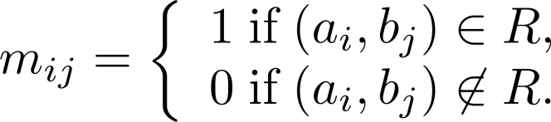
Relation – Representation
Matrices: A relation R between finite sets can be represented using a zero-one matrix
A = {a₁, a₂, …, a_{m}}
B = {b₁, b₂, …, b_{n}}
R is a relation from A to B

Slide 96
Relation – Representation
Example 01: Suppose that A = {1,2,3} and B = {1,2}. Let R be the relation from A to B containing (a,b) if a ∈ A, b ∈ B, and a > b. What is the matrix representing R (assuming the ordering of elements is the same as the increasing numerical order)?

Slide 97
Relation – Representation
Example 01: Suppose that A = {1,2,3} and B = {1,2}. Let R be the relation from A to B containing (a,b) if a ∈ A, b ∈ B, and a > b. What is the matrix representing R (assuming the ordering of elements is the same as the increasing numerical order)?
R = {(2,1), (3,1),(3,2)}

Slide 98
Relation – Representation
Example 01: Suppose that A = {1,2,3} and B = {1,2}. Let R be the relation from A to B containing (a,b) if a ∈ A, b ∈ B, and a > b. What is the matrix representing R (assuming the ordering of elements is the same as the increasing numerical order)?
R = {(2,1), (3,1),(3,2)}

Slide 99
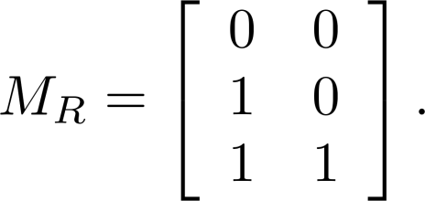
Relation – Representation
Example 01: Suppose that A = {1,2,3} and B = {1,2}. Let R be the relation from A to B containing (a,b) if a ∈ A, b ∈ B, and a > b. What is the matrix representing R (assuming the ordering of elements is the same as the increasing numerical order)?
R = {(2,1), (3,1),(3,2)}

Slide 100
Relation – Representation
Example 02: Let A = {a₁,a₂, a₃} and B = {b₁,b₂, b₃,b₄, b₅}. Which ordered pairs are in the relation R represented by the matrix

Slide 101
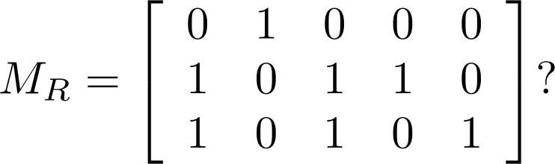
Relation – Representation
Example 02: Let A = {a₁,a₂, a₃} and B = {b₁,b₂, b₃,b₄, b₅}. Which ordered pairs are in the relation R represented by the matrix

Slide 102
Relation – Representation
Example 02: Let A = {a₁,a₂, a₃} and B = {b₁,b₂, b₃,b₄, b₅}. Which ordered pairs are in the relation R represented by the matrix

Slide 103
Relation – Representation
Example 02: Let A = {a₁,a₂, a₃} and B = {b₁,b₂, b₃,b₄, b₅}. Which ordered pairs are in the relation R represented by the matrix
R = {(a₁, b₂), (a₂, b₁),(a₂, b₃), (a₂, b₄),(a₃, b₁), {(a₃, b₃), (a₃, b₅)}

Slide 104
Relation – Matrices vs Types
Reflexive:

Slide 105
Relation – Matrices vs Types
Reflexive: If R is a reflexive relation, all the elements on the main diagonal of M_{R} are equal to 1

Slide 106
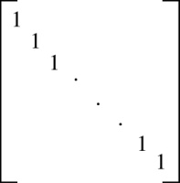
Relation – Matrices vs Types
Reflexive: If R is a reflexive relation, all the elements on the main diagonal of M_{R} are equal to 1

Slide 107
Relation – Matrices vs Types
Symmetric:

Slide 108
Relation – Matrices vs Types
Symmetric: R is a symmetric relation, if and only if m_{ij} = 1 whenever m_{ji} = 1.

Slide 109
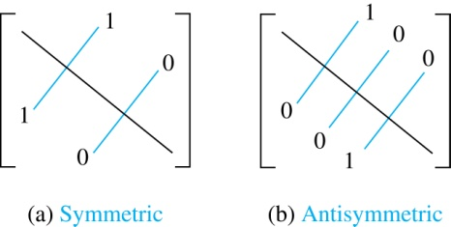
Relation – Matrices vs Types
Symmetric: R is a symmetric relation, if and only if m_{ij} = 1 whenever m_{ji} = 1.

Slide 110
Relation – Matrices vs Types
Antisymmetric:

Slide 111
Relation – Matrices vs Types
Antisymmetric: R is an antisymmetric relation, if and only if m_{ij} = 0 or m_{ji} = 0 when i≠ j

Slide 112
Relation – Matrices vs Types
Antisymmetric: R is an antisymmetric relation, if and only if m_{ij} = 0 or m_{ji} = 0 when i≠ j

Slide 113
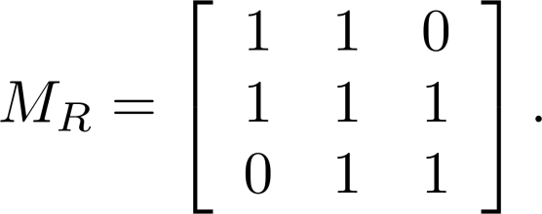
Relation – Matrices vs Types
Example 01: Suppose that the relation R on a set is represented by the matrix
Type of Relation

Slide 114
Relation – Matrices vs Types
Example 01: Suppose that the relation R on a set is represented by the matrix
Type of Relation
R is reflexive

Slide 115
Relation – Matrices vs Types
Example 01: Suppose that the relation R on a set is represented by the matrix
Type of Relation
R is reflexive
R is Symmetric

Slide 116
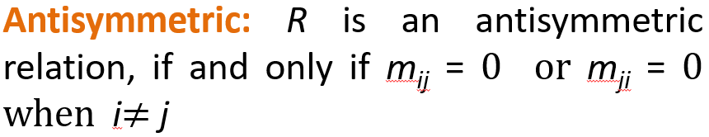
Relation – Matrices vs Types
Example 01: Suppose that the relation R on a set is represented by the matrix
Type of Relation
R is reflexive
R is Symmetric

Slide 117
Relation – Matrices vs Types
Example 01: Suppose that the relation R on a set is represented by the matrix
Type of Relation
R is reflexive
R is Symmetric
R is not antisymmetric

Slide 118
Relation – Matrices vs Types
Example 01: Suppose that the relation R on a set is represented by the matrix
Type of Relation
R is reflexive
R is Symmetric
R is not antisymmetric (as (2,3) ∈ R and (3,2) ∈ R)

Slide 119
Relation – Representation
Diagraph:

Slide 120
Relation – Representation
Diagraph: A directed graph, or digraph, consists of a set V of vertices (or nodes) together with a set E of ordered pairs of elements of V called edges (or arcs). The vertex a is called the initial vertex of the edge (a,b), and the vertex b is called the terminal vertex of this edge

Slide 121
Relation – Representation
Diagraph: A directed graph, or digraph, consists of a set V of vertices (or nodes) together with a set E of ordered pairs of elements of V called edges (or arcs). The vertex a is called the initial vertex of the edge (a,b), and the vertex b is called the terminal vertex of this edge
An edge of the form (a,a) is called a loop

Slide 122
Relation – Representation
Example 01: Draw a directed graph with vertices a, b, c, and d, and edges (a, b), (a, d), (b, b), (b, d), (c, a), (c, b), and (d, b)

Slide 123
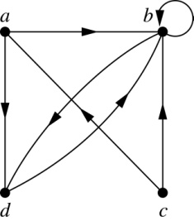
Relation – Representation
Example 01: Draw a directed graph with vertices a, b, c, and d, and edges (a, b), (a, d), (b, b), (b, d), (c, a), (c, b), and (d, b)

Slide 124
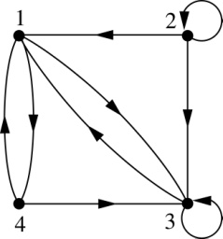
Relation – Representation
Example 02: What are the ordered pairs in the relation represented by this directed graph?

Slide 125
Relation – Representation
Example 02: What are the ordered pairs in the relation represented by this directed graph?
(1, 3), (1, 4), (2, 1), (2, 2), (2, 3), (3, 1), (3, 3), (4, 1), (4, 3)

Slide 126
Relation – Diagraph vs Types
Reflexive: A loop must be present at all vertices in the graph
Symmetric: If (x, y) is an edge, then (y, x) must be an edge too
Antisymmetric: If (x, y) with x ≠ y is an edge, then (y, x) is not an edge
Transitive: If (x, y) and (y, z) are edges, then so is (x, z)

Slide 127
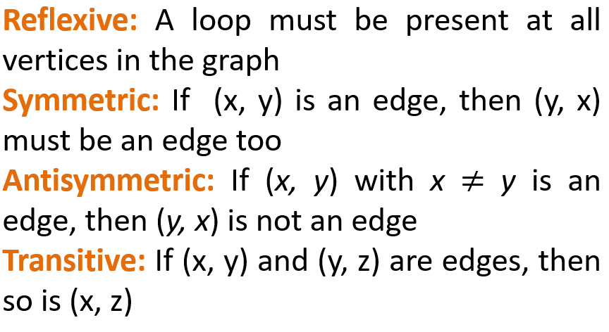
Relation – Diagraph vs Types
Example 01:
a
b
c
d

Slide 128
Relation – Diagraph vs Types
Example 01:
Reflexive
Symmetric
Antisymmetric
Transitive
a
b
c
d

Slide 129
Relation – Diagraph vs Types
Example 01:
Reflexive
No loop on b , c and d
Symmetric
Antisymmetric
Transitive
a
b
c
d

Slide 130

Relation – Diagraph vs Types
Example 01:
Reflexive
No loop on b , c and d
Symmetric
No edges
Antisymmetric
Transitive
a
b
c
d

Slide 131
Relation – Diagraph vs Types
Example 01:
Reflexive
No loop on b , c and d
Symmetric
No edges
Antisymmetric
No edges
Transitive
a
b
c
d

Slide 132
Relation – Diagraph vs Types
Example 01:
Reflexive
No loop on b , c and d
Symmetric
(a , a) and (a , a) are there
Antisymmetric
(a , a) is there with a = a
Transitive
(a , a) and (a , a) implies (a , a)
a
b
c
d

Slide 133
Relation – Diagraph vs Types
Example 02:
Reflexive
Symmetric
Antisymmetric
Transitive
a
b
c
d

Slide 134
Relation – Diagraph vs Types
Example 02:
Reflexive
No loop on a , b, c, and d
Symmetric
Antisymmetric
Transitive
a
b
c
d

Slide 135
Relation – Diagraph vs Types
Example 02:
Reflexive
No loop on a , b, c, and d
Symmetric
No edge from b to a
Antisymmetric
Transitive
a
b
c
d

Slide 136
Relation – Diagraph vs Types
Example 02:
Reflexive
No loop
Symmetric
No edge from b to a
Antisymmetric
Edges b to d & d to b but b ≠ d
Transitive
a
b
c
d

Slide 137
Relation – Diagraph vs Types
Example 02:
Reflexive
No loop
Symmetric
No edge from b to a
Antisymmetric
Edge b to d & d to b
Transitive
Edge a to b, b to d but no edge from a to d
a
b
c
d

Slide 138
Relation – Diagraph vs Types
Example 03:
Reflexive
Symmetric
Antisymmetric
Transitive
a
b
c
d

Slide 139
Relation – Diagraph vs Types
Example 03:
Reflexive
No loop on a , b , c and d
Symmetric
Antisymmetric
Transitive
a
b
c
d

Slide 140
Relation – Diagraph vs Types
Example 03:
Reflexive
No loop on a , b , c and d
Symmetric
No edge from c to a
Antisymmetric
Transitive
a
b
c
d

Slide 141

Relation – Diagraph vs Types
Example 03:
Reflexive
No loop on a , b , c and d
Symmetric
No edge from c to a
Antisymmetric
No two way edges
Transitive
a
b
c
d

Slide 142
Relation – Diagraph vs Types
Example 03:
Reflexive
No loop on a , b , c and d
Symmetric
No edge from c to a
Antisymmetric
No two way edges
Transitive
Edge a to c, c to b and also an edge from a to b
a
b
c
d

Slide 143
Relation – Diagraph vs Types
Example 04:
Reflexive
Symmetric
Antisymmetric
Transitive
b
a
c
d

Slide 144
Relation – Diagraph vs Types
Example 04:
Reflexive
No loop
Symmetric
Antisymmetric
Transitive
b
a
c
d

Slide 145
Relation – Diagraph vs Types
Example 04:
Reflexive
No loop
Symmetric
No edge from d to a
Antisymmetric
Transitive
b
a
c
d

Slide 146
Relation – Diagraph vs Types
Example 04:
Reflexive
No loop
Symmetric
No edge from d to a
Antisymmetric
No two way edges
Transitive
b
a
c
d

Slide 147
Relation – Diagraph vs Types
Example 04:
Reflexive
No loop
Symmetric
No edge from d to a
Antisymmetric
No two way edges
Transitive
there are no two edges where the first edge ends at the vertex where the second edge begins
b
a
c
d

Slide 148
Relation – Equivalence Relations
Definition: A relation on a set A is called an equivalence; if it is reflexive, symmetric, and transitive

Slide 149
Relation – Equivalence Relations
Definition: A relation on a set A is called an equivalence; if it is reflexive, symmetric, and transitive
Definition: Two elements a, and b that are related by an equivalence relation are called equivalent. The notation a ∼ b is often used to denote that a and b are equivalent elements with respect to a particular equivalence relation

Slide 150
Relation – Equivalence Relations
Example01: Suppose that R is the relation on the set of strings of English letters such that aRb if and only if l(a) = l(b), where l(x) is the length of the string x. Is R an equivalence relation?

Slide 151
Relation – Equivalence Relations
Example01: Suppose that R is the relation on the set of strings of English letters such that aRb if and only if l(a) = l(b), where l(x) is the length of the string x. Is R an equivalence relation?
Reflexive:
Symmetric:
Transitive:

Slide 152
Relation – Equivalence Relations
Example01: Suppose that R is the relation on the set of strings of English letters such that aRb if and only if l(a) = l(b), where l(x) is the length of the string x. Is R an equivalence relation?
Reflexive: Because l(a) = l(a), it follows that aRa for all strings a
Symmetric:
Transitive:

Slide 153
Relation – Equivalence Relations
Example01: Suppose that R is the relation on the set of strings of English letters such that aRb if and only if l(a) = l(b), where l(x) is the length of the string x. Is R an equivalence relation?
Reflexive: Because l(a) = l(a), it follows that aRa for all strings a
Symmetric: Suppose that aRb. Since l(a) = l(b), l(b) = l(a) also holds and bRa
Transitive:

Slide 154
Relation – Equivalence Relations
Example01: Suppose that R is the relation on the set of strings of English letters such that aRb if and only if l(a) = l(b), where l(x) is the length of the string x. Is R an equivalence relation?
Reflexive: Because l(a) = l(a), it follows that aRa for all strings a
Symmetric: Suppose that aRb. Since l(a) = l(b), l(b) = l(a) also holds and bRa
Transitive: Suppose that aRb and bRc. Since l(a) = l(b),and l(b) = l(c), l(a) = l(c) also holds and aRc

Slide 155
Relation – Equivalence Relations
Example02: Let m be an integer with m > 1. Show that the relation R = {(a,b) | a ≡ b (mod m)} is an equivalence relation on the set of integers
Recall that a ≡ b (mod m) if and only if m divides a − b

Slide 156
Relation – Equivalence Relations
Example02: Let m be an integer with m > 1. Show that the relation R = {(a,b) | a ≡ b (mod m)} is an equivalence relation on the set of integers
Recall that a ≡ b (mod m) if and only if m divides a − b
Reflexive:

Slide 157
Relation – Equivalence Relations
Example02: Let m be an integer with m > 1. Show that the relation R = {(a,b) | a ≡ b (mod m)} is an equivalence relation on the set of integers
Recall that a ≡ b (mod m) if and only if m divides a − b
Reflexive: a ≡ a (mod m) since a − a = 0 is divisible by m since

Slide 158
Relation – Equivalence Relations
Example02: Let m be an integer with m > 1. Show that the relation R = {(a,b) | a ≡ b (mod m)} is an equivalence relation on the set of integers
Recall that a ≡ b (mod m) if and only if m divides a − b
Reflexive: a ≡ a (mod m) since a − a = 0 is divisible by m since
Symmetric:

Slide 159
Relation – Equivalence Relations
Example02: Let m be an integer with m > 1. Show that the relation R = {(a,b) | a ≡ b (mod m)} is an equivalence relation on the set of integers
Recall that a ≡ b (mod m) if and only if m divides a − b
Reflexive: a ≡ a (mod m) since a − a = 0 is divisible by m since
Symmetric: Suppose that a ≡ b (mod m). Then a − b is divisible by m, and so a − b = km, where k is an integer. It follows that b − a = (− k) m, so b ≡ a (mod m)

Slide 160
Relation – Equivalence Relations
Example02: Let m be an integer with m > 1. Show that the relation R = {(a,b) | a ≡ b (mod m)} is an equivalence relation on the set of integers
Recall that a ≡ b (mod m) if and only if m divides a − b
Transitive:

Slide 161
Relation – Equivalence Relations
Example02: Let m be an integer with m > 1. Show that the relation R = {(a,b) | a ≡ b (mod m)} is an equivalence relation on the set of integers
Recall that a ≡ b (mod m) if and only if m divides a − b
Transitive: Suppose that a ≡ b (mod m) and b ≡ c (mod m).

Slide 162
Relation – Equivalence Relations
Example02: Let m be an integer with m > 1. Show that the relation R = {(a,b) | a ≡ b (mod m)} is an equivalence relation on the set of integers
Recall that a ≡ b (mod m) if and only if m divides a − b
Transitive: Suppose that a ≡ b (mod m) and b ≡ c (mod m). Then m divides both a − b and b − c. Hence, there are integers k and l

Slide 163
Relation – Equivalence Relations
Example02: Let m be an integer with m > 1. Show that the relation R = {(a,b) | a ≡ b (mod m)} is an equivalence relation on the set of integers
Recall that a ≡ b (mod m) if and only if m divides a − b
Transitive: Suppose that a ≡ b (mod m) and b ≡ c (mod m). Then m divides both a − b and b − c. Hence, there are integers k and l with a − b = km and b − c = lm. We obtain by adding the equations:

Slide 164
Relation – Equivalence Relations
Example02: Let m be an integer with m > 1. Show that the relation R = {(a,b) | a ≡ b (mod m)} is an equivalence relation on the set of integers
Recall that a ≡ b (mod m) if and only if m divides a − b
Transitive: Suppose that a ≡ b (mod m) and b ≡ c (mod m). Then m divides both a − b and b − c. Hence, there are integers k and l with a − b = km and b − c = lm. We obtain by adding the equations:
a − c = (a − b) + (b − c) = km + lm = (k + l) m

Slide 165
Relation – Equivalence Relations
Example02: Let m be an integer with m > 1. Show that the relation R = {(a,b) | a ≡ b (mod m)} is an equivalence relation on the set of integers
Recall that a ≡ b (mod m) if and only if m divides a − b
Transitive: Suppose that a ≡ b (mod m) and b ≡ c (mod m). Then m divides both a − b and b − c. Hence, there are integers k and l with a − b = km and b − c = lm. We obtain by adding the equations:
a − c = (a − b) + (b − c) = km + lm = (k + l) m
Therefore, a ≡ c (mod m)

Slide 166
Relation – Equivalence Relations
Example03: Show that the “divides” relation on the set of positive integers is not an equivalence relation
Reflexive:
Symmetric:
Transitive:

Slide 167
Relation – Equivalence Relations
Example03: Show that the “divides” relation on the set of positive integers is not an equivalence relation
Reflexive: a / a for all a
Symmetric:
Transitive:

Slide 168
Relation – Equivalence Relations
Example03: Show that the “divides” relation on the set of positive integers is not an equivalence relation
Reflexive: a / a for all a
Symmetric: For example, 4 / 2, but 2 ∤ 4. Hence, the relation is not symmetric
Transitive:

Slide 169
Relation – Equivalence Relations
Example03: Show that the “divides” relation on the set of positive integers is not an equivalence relation
Reflexive: a / a for all a
Symmetric: For example, 4 / 2, but 2 ∤ 4. Hence, the relation is not symmetric
Transitive: Suppose that a divides b and b divides c. Then there are positive integers k and l such that b = ak and c = bl. Hence, c = a(kl), so a divides c. Therefore, the relation is transitive

